Slide 1
Distribution Week 7

Slide 2
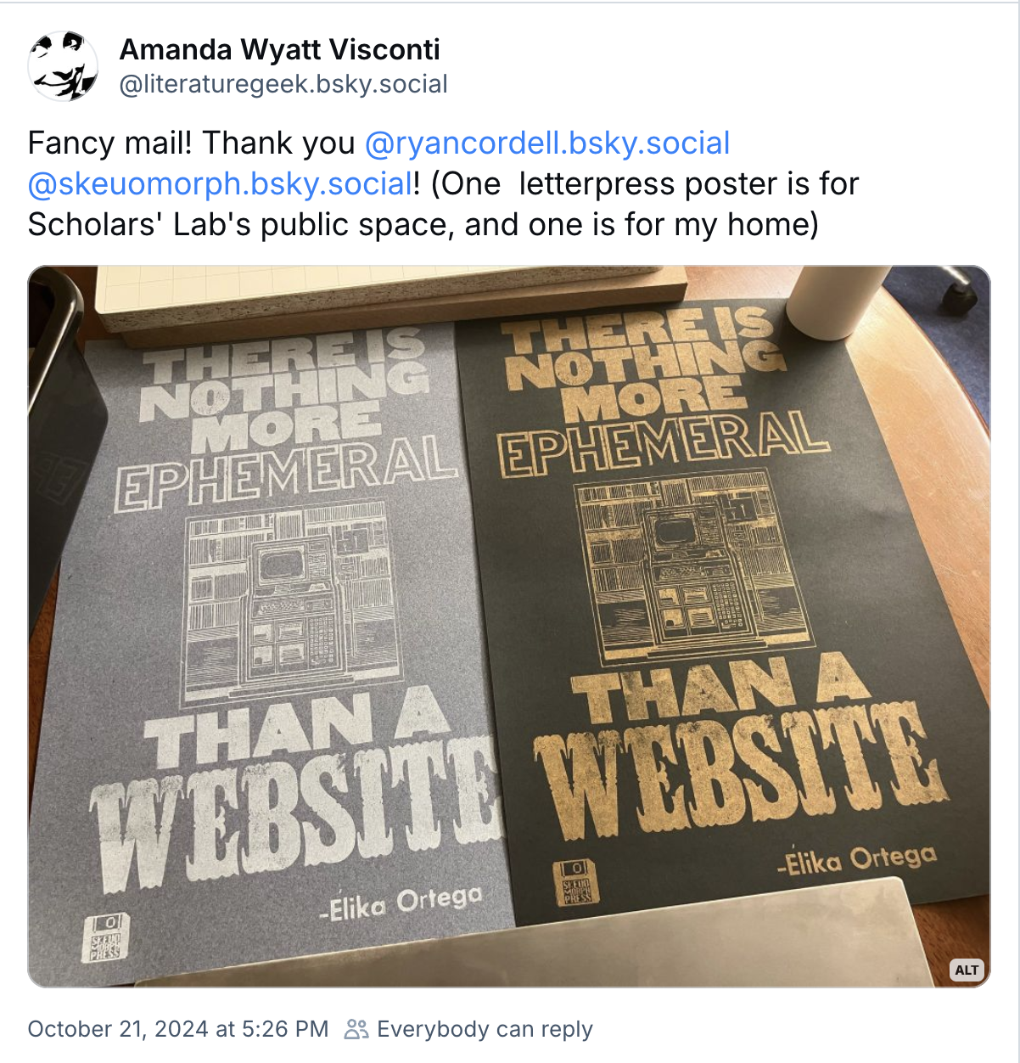

Slide 3
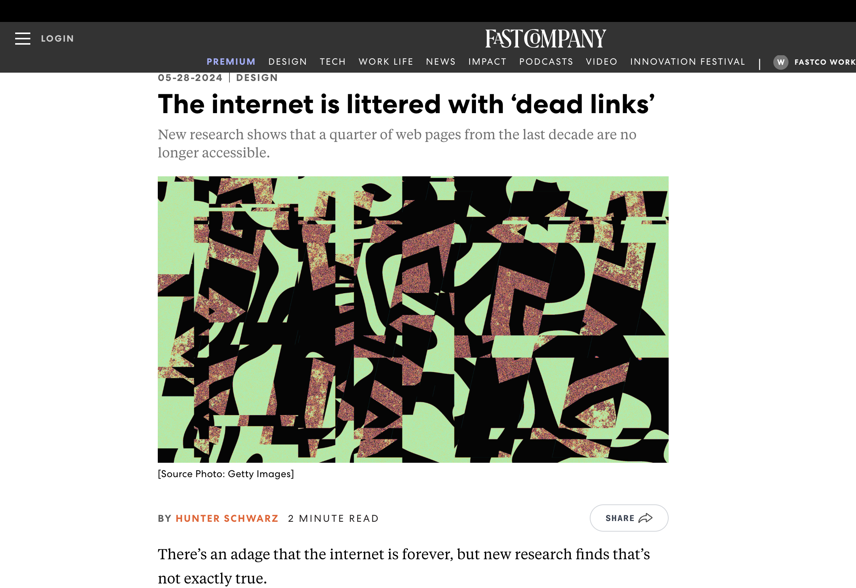

Slide 4
Distributing Data – Key Topics Today
Platforms are not all the same!
Documentation first
Helpful to give some instructions for how to use the materials.
Ethical considerations – what rights do you have?
What rights do you give over?

Slide 5
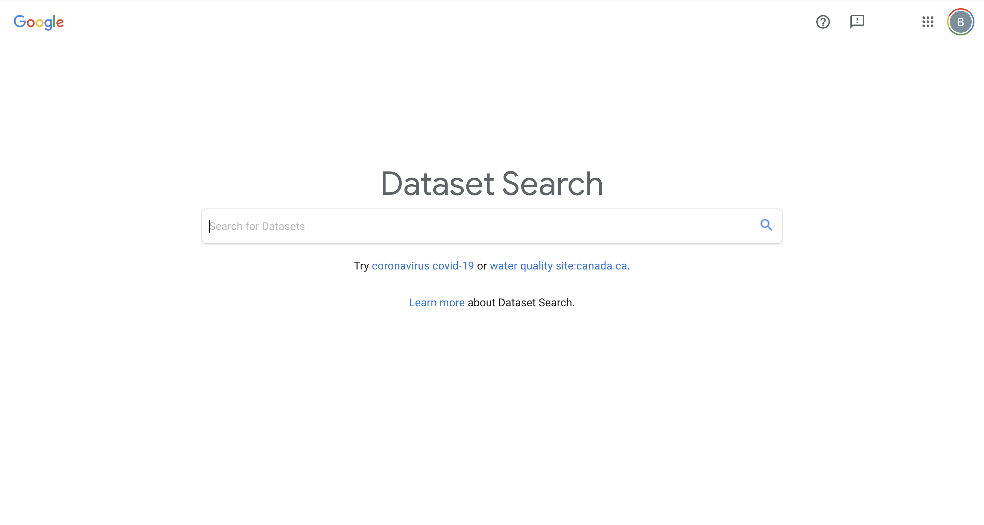
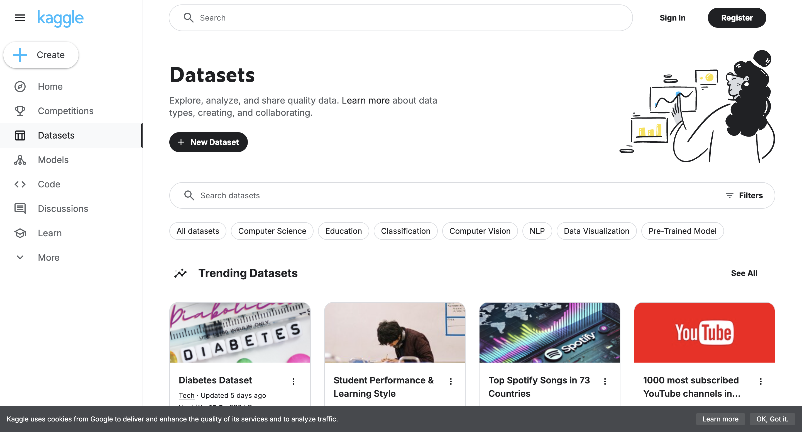

Slide 6
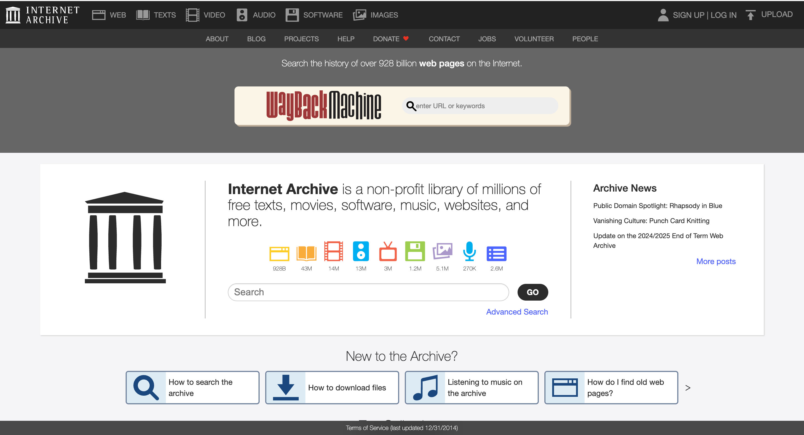

Slide 7


Slide 8
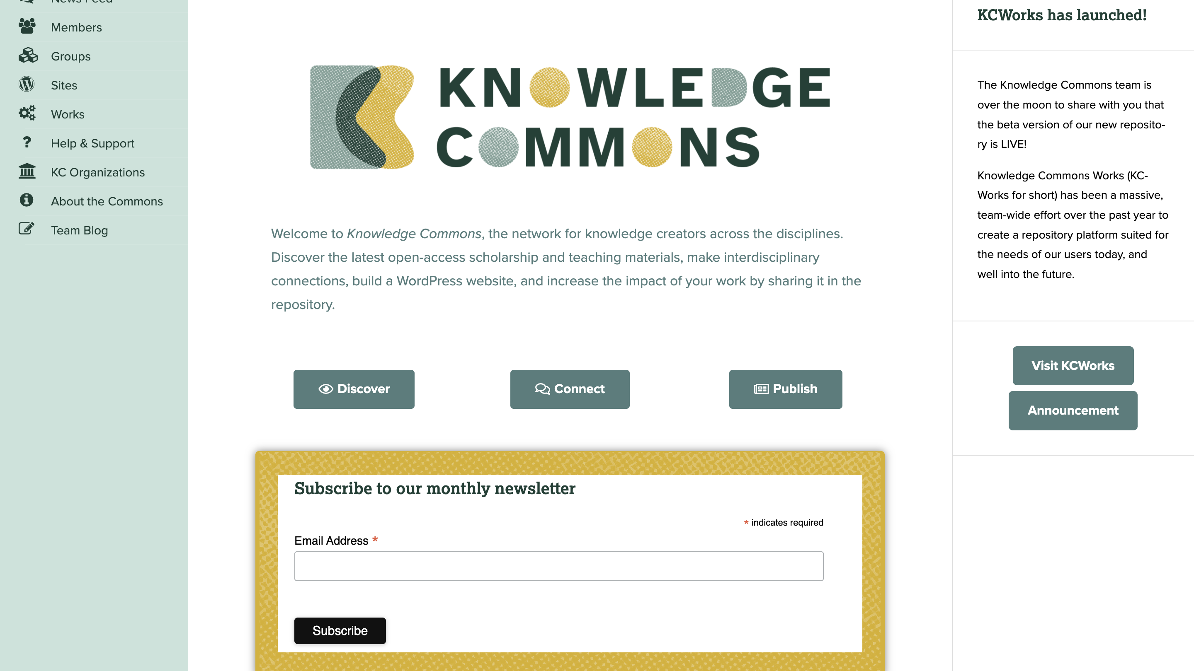

Slide 9
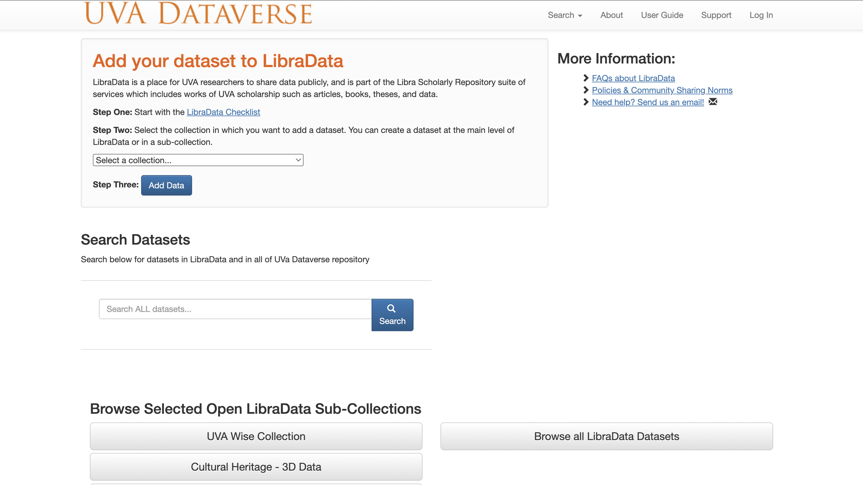

Slide 10
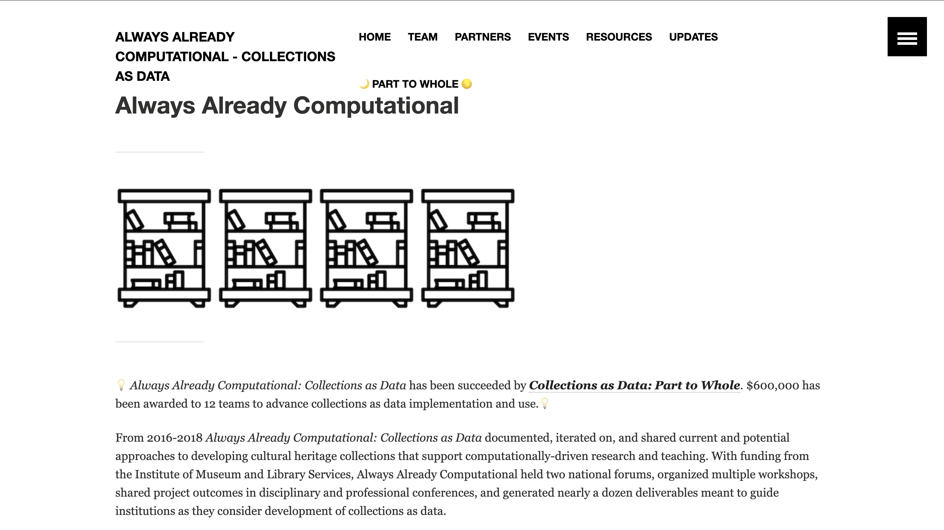

Slide 11
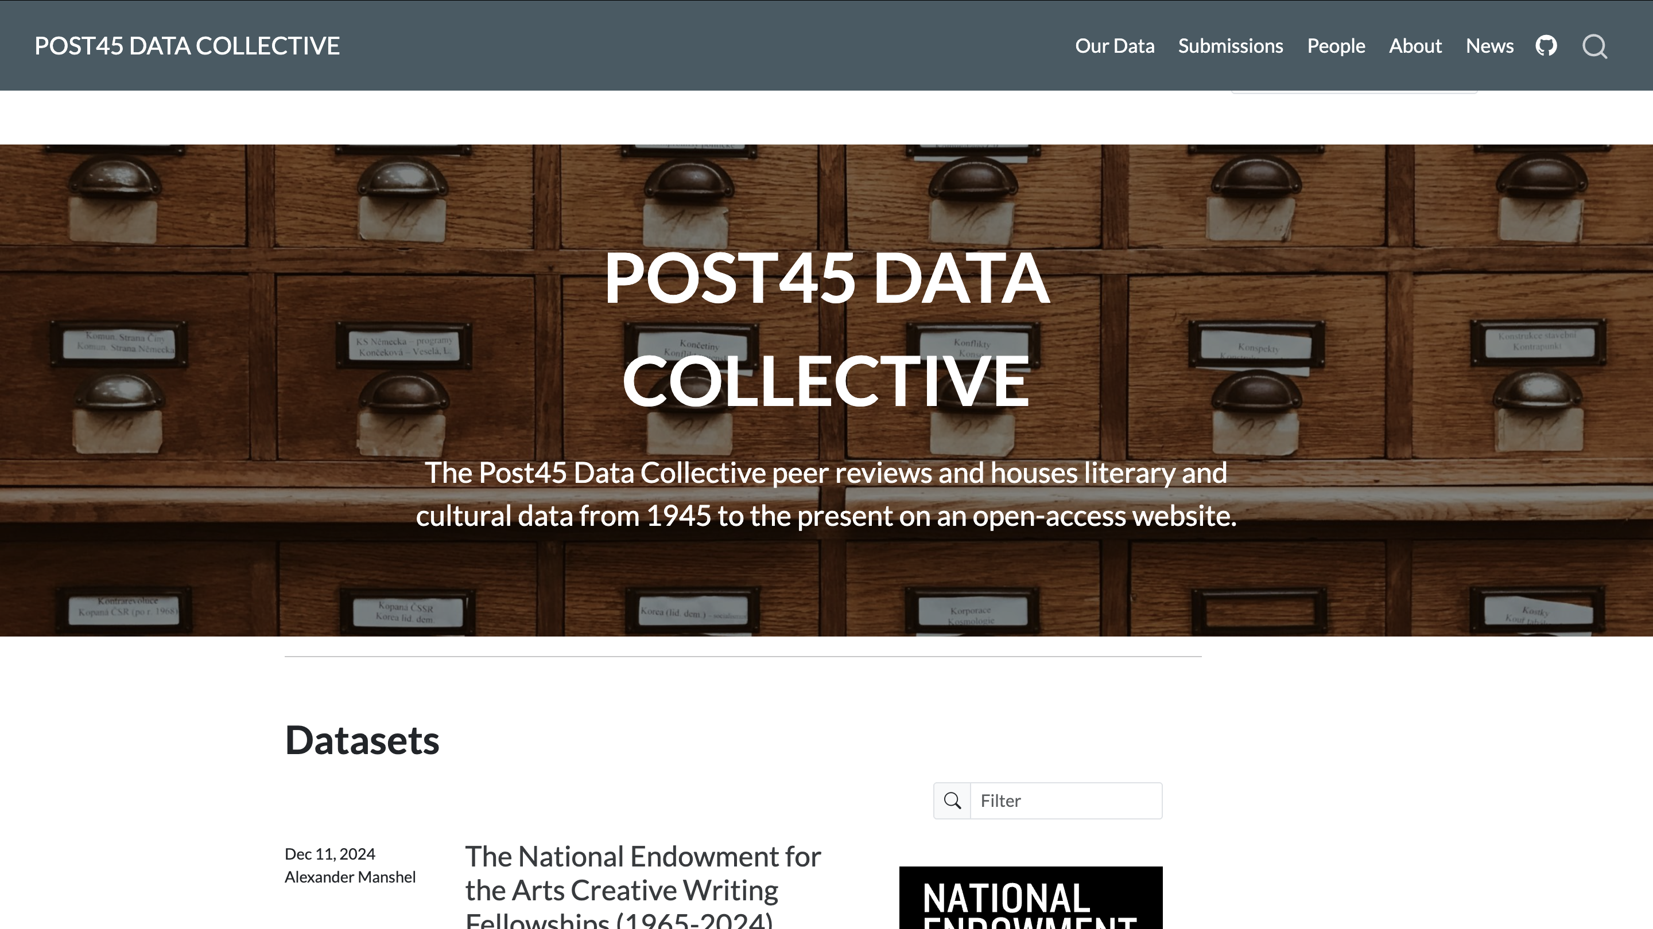

Slide 12
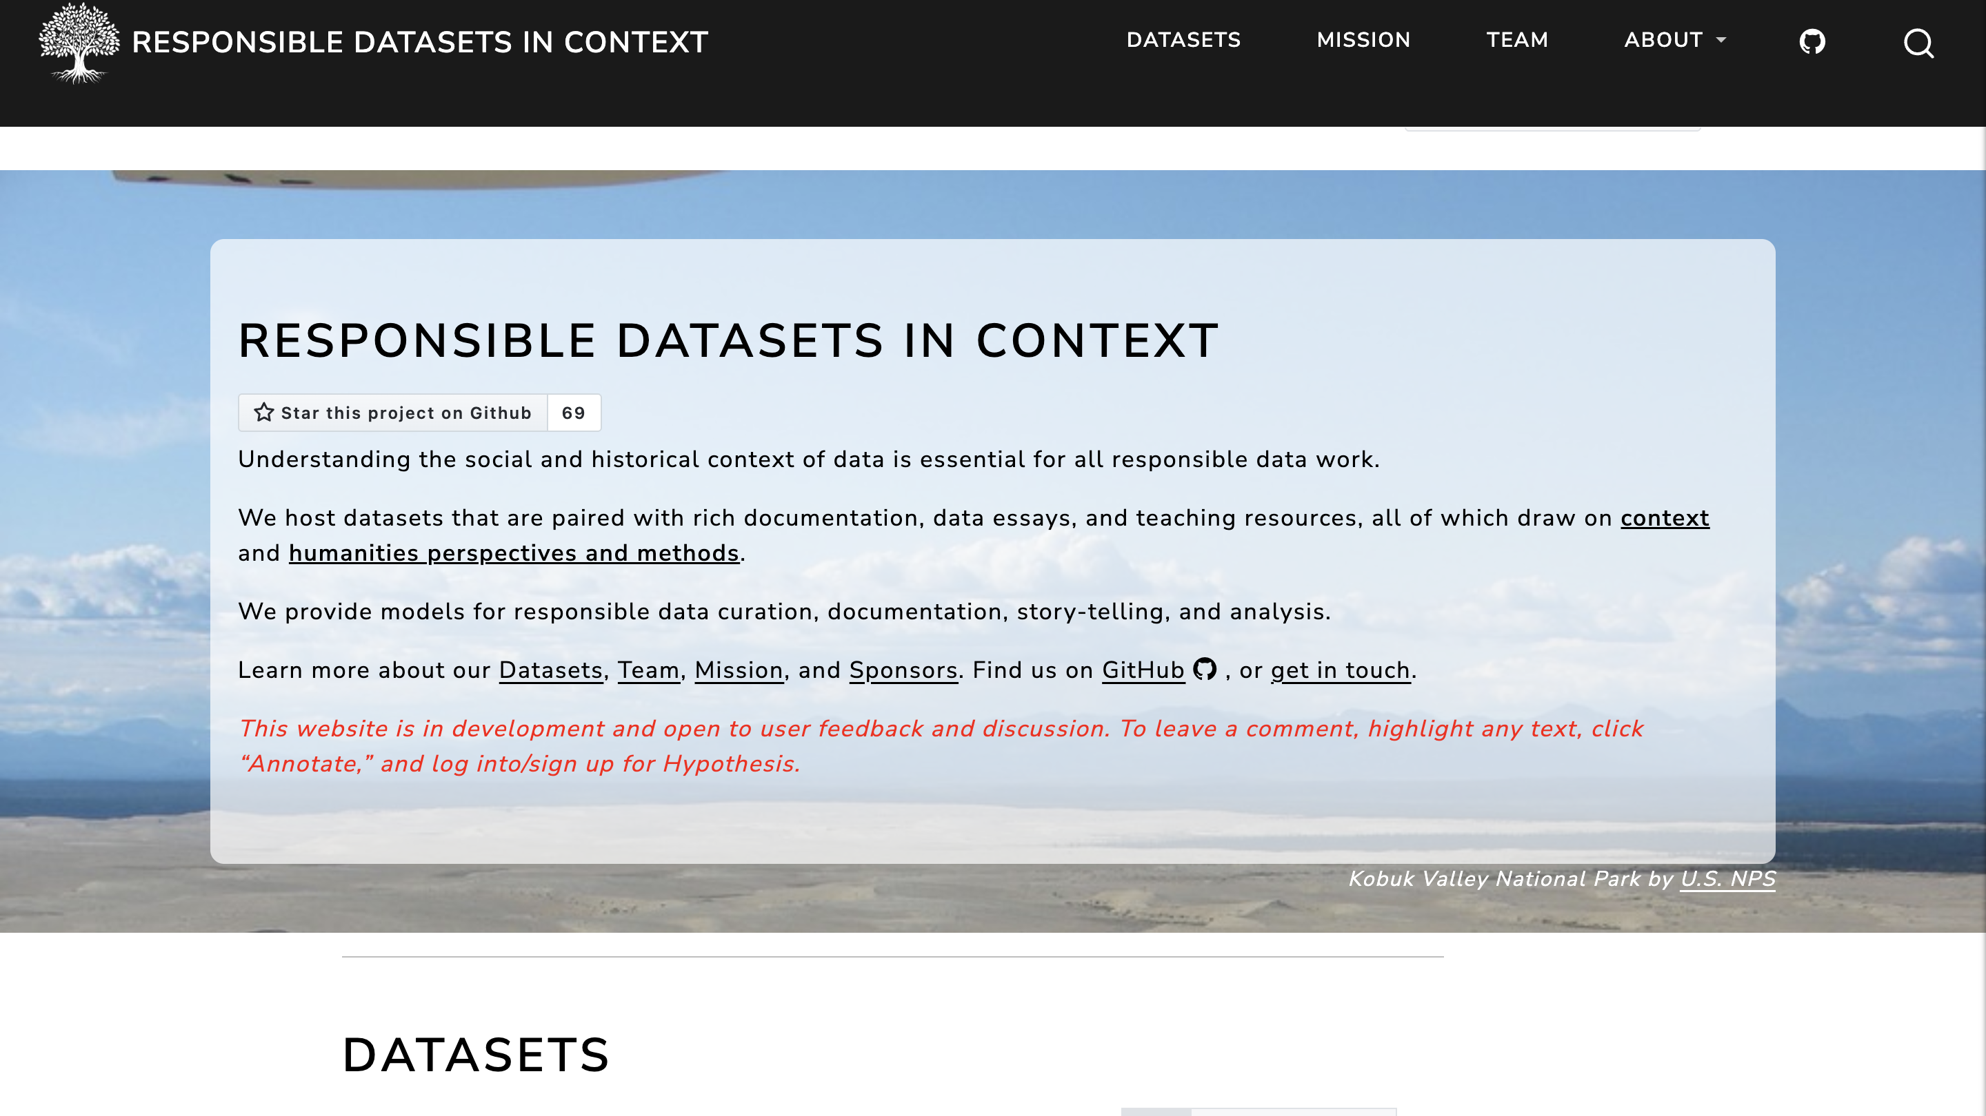

Slide 13
Places to Distribute
Institutional
Knowledge Commons
UVA
Corporate
GitHub (Microsoft)
Google Datasets
Regional
Zenodo (European)
Content Specific
Post 1945 Data Collective
Responsible Datasets in Context
Questions to Consider
Ethics
Rights ownership
Preservation

Slide 14
Documentation
Depositing is not enough!
Describe the work that you did so others can use it.
Can involve…
Metadata description
Narrative and context for the materials
Example use cases
Teaching materials

Slide 15
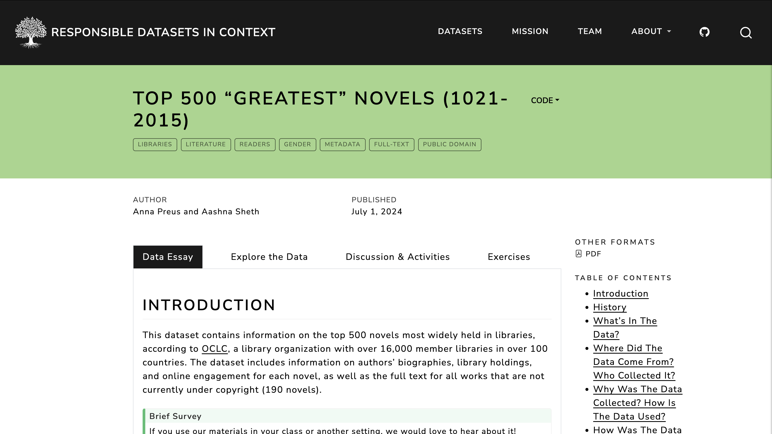

Slide 16
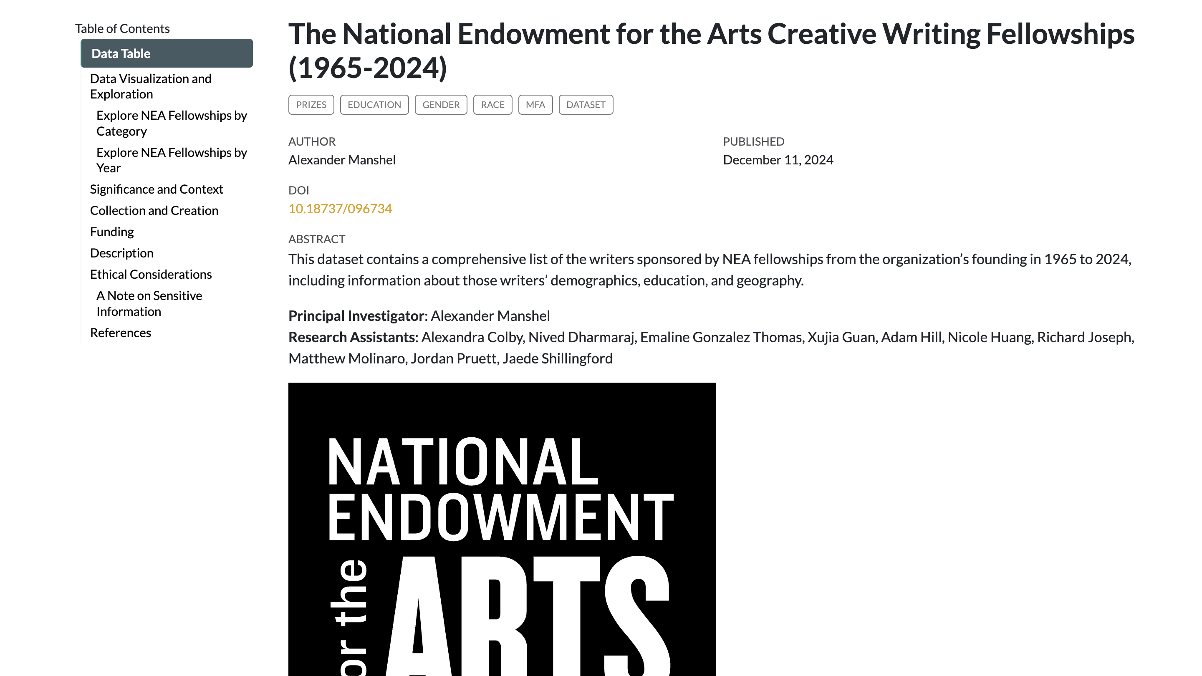

Slide 17
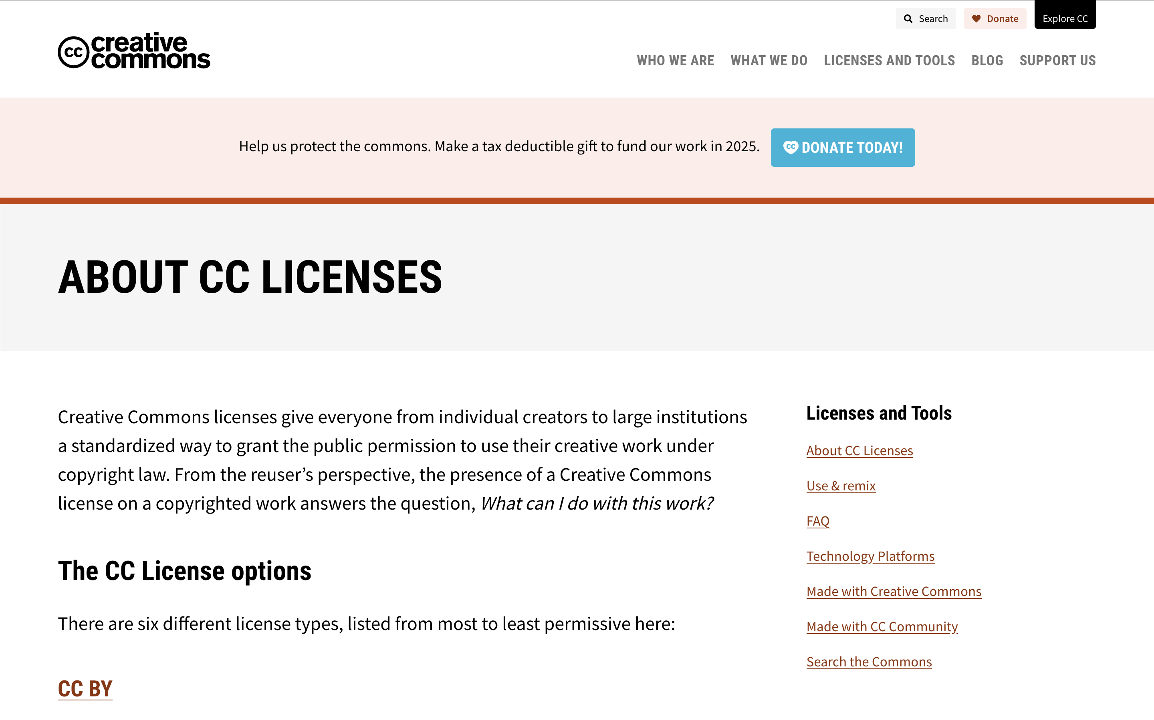
Crash Course in Copyright and Licensing

Slide 18
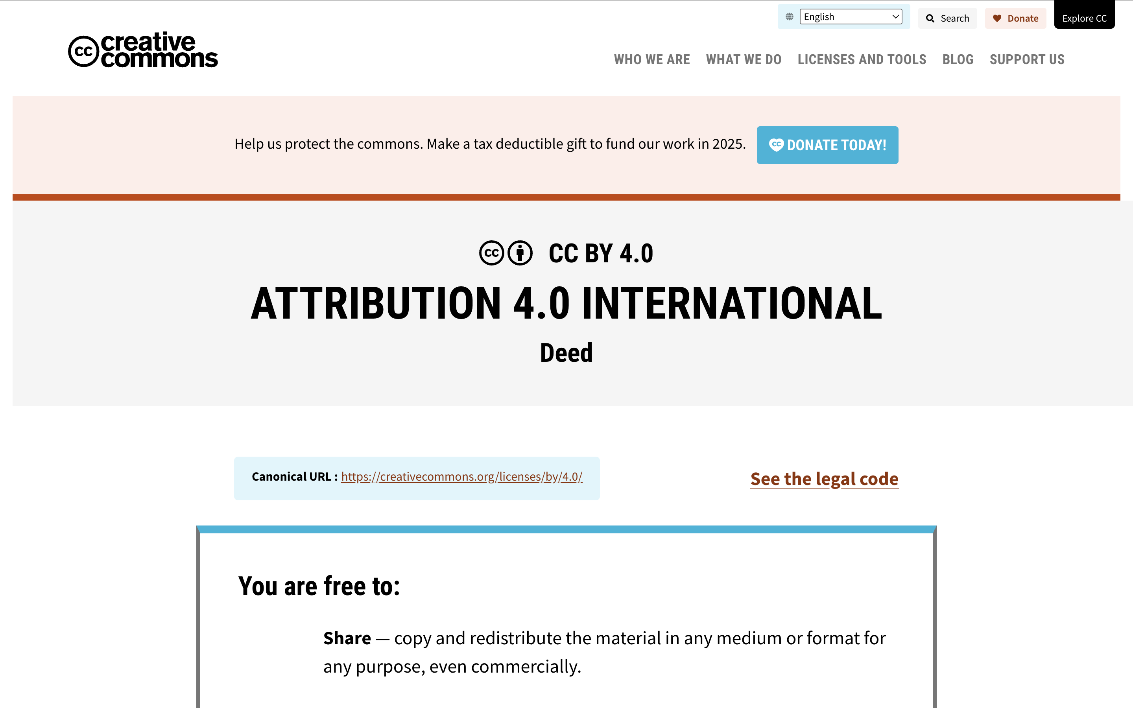
Creative Commons Crash Course
Select basic copyright terms for your work
Can it be reused?
Do you require attribution?
For commercial purposes?
I use CC By

Slide 19
How to Get Started – Make a Data Plan
Make a data sharing plan for your dataset.
What will you share? How?
What will you not share?
What rights will you give it?
What documentation will you provide?
What stories will you encourage others to tell with it?
Notes:
For remaining time

Slide 20
Your Final Project – Distribute Your Work
Task is to follow the steps of the course units to create a dataset
Outcome will look like these examples
Includes:
Collected, cleaned data
Metadata breakdown
Narrative of the dataset
Usage examples
Basic analysis
Credits

Slide 21
Groups
Group 1
Wardah
Mimi
Gloria
Group 2
Bex
Gillian
Abby
Molly
Group 3
Jacob
Lucas
Paul
Group 4
Harrison
Jennifer
Choa

Slide 22
A Few Notes
Spend time researching the site’s permissions and rights for automated collection.
Some of you mentioned APIs – fine but make sure you know what you are getting into
Approach with care and ask me if you have questions

Slide 23
Group Time
Next session you will have 15 minutes (10 minutes talking plus 5 Q&A) to present two project ideas for feedback.
Answer these questions in your presentations:
What is the data? Why do we care?
How viable does it seem to collect the data? to clean it?
What questions might someone answer with the dataset that can’t otherwise be answered?
Are there any concerns about doing this work on this data, ethical or legal?
What are the pro’s and cons of each data source?
Which stories are you most interested in?
I tried to find a bucket of interest that connected you to the people in your groups.
The remainder of your time today is work time.
I’d suggest:
Share your own preliminary ideas from the previous homework. Find the bucket that connected you. Focus on that.

Slide 24
Homework
Meet in your groups to discuss your potential project ideas. As a group, you will pitch two potential ideas to a group of judges next time. This means you will have to select which ideas you will propose.
Upload the list of your group’s two ideas and then some preliminary work towards the following:
Answer these questions in your presentations:
What is the data? Why do we care?
How viable does it seem to collect the data? to clean it?
What questions might someone answer with the dataset that can’t otherwise be answered?
Are there any concerns about doing this work on this data, ethical or legal?
What are the pro’s and cons of each data source?
Which stories are you most interested in?
A note on the class going forward after spring break

